Slide 1
Lecture 5: Intro to Supervised Learning
Intro to Data Science for Public Policy
Spring 2018
Jeff Chen

Slide 2
Roadmap
Homeworks #1 and #2
Motivation
Supervised Learning
OLS
Homework assignment
Intro to Data Science for Public Policy, Spring 2018

Slide 3
Homework #1 Observations
Grade distribution (10 max)
Time to Process (Seconds)
Intro to Data Science for Public Policy, Spring 2018
Notes:
9.2

Slide 4
Homework #2 Observations
Grade distribution (10 max)
Intro to Data Science for Public Policy, Spring 2018
Notes:
Average = 8.9

Slide 5
Roadmap
Homeworks #1 and #2
Motivation
Supervised Learning
OLS
Homework assignment
Intro to Data Science for Public Policy, Spring 2018

Slide 6
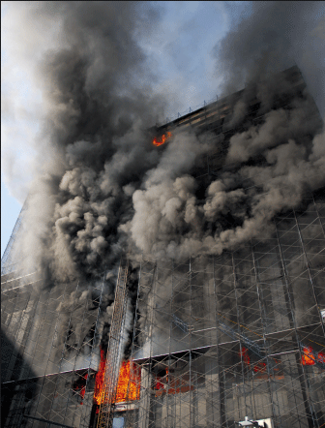

The Deutsche Bank Fire (2007)
In 2007 the Deutsche Bank building was in the process of being remediated and demolished
Fire engulfed the building killing two firefighters
Overview
Notes:
Motivating point

Slide 7
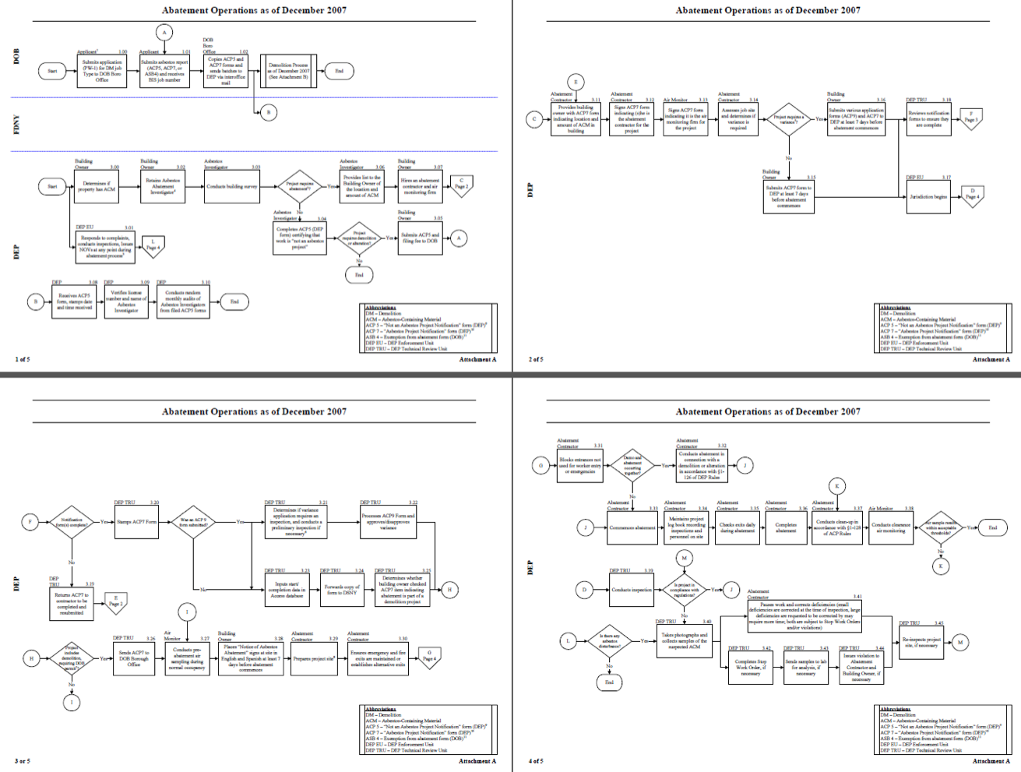
Systemic Problems with NYC Building Policy
“FDNY, DOB, and DEP should review the criteria they use to prioritize inspections (new buildings and demolitions for DOB) and affirm, or make appropriate adjustments to ensure that, to the extent possible, these inspections are prioritized on the basis of risk.”
- CDA Report
Notes:
An investigation found that the tell-tale signs of fire were already in administrative records. The missing piece was bringing it all together for a risk based approach.

Slide 8
Risk Mitigation Philosophy
Fires will happen. It’s just a matter of time. The Fire Department needs to get fire units to inspect the buildings of highest risk so they’re ready.
Overview
Notes:
Roth: Main point:
[]

Slide 9
Considerations for Inspection Activities
330,000
# of buildings in inspection portfolio
10%
Expected proportion that will be inspected per year
3x3
Each company performs 3 hours of building inspections, 3 times per week
493,000
# of fire incidents per year
(# of times an emergency could cut into building inspection time)
105
Heat index value at which inspection operations are suspended
Overview
Notes:
Roth: Main point:
[]

Slide 10
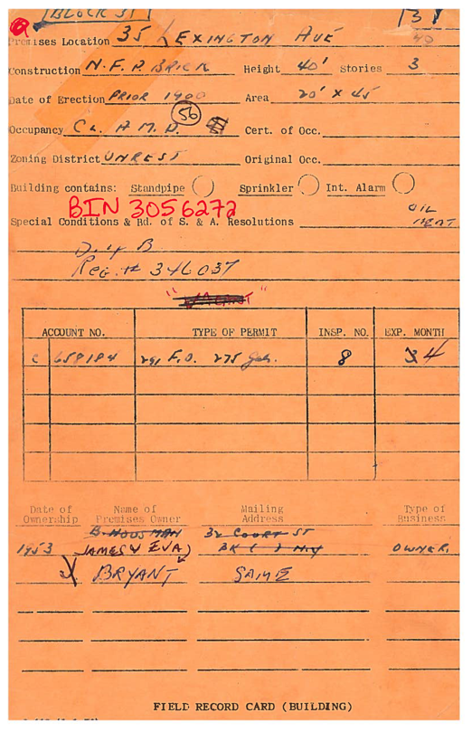
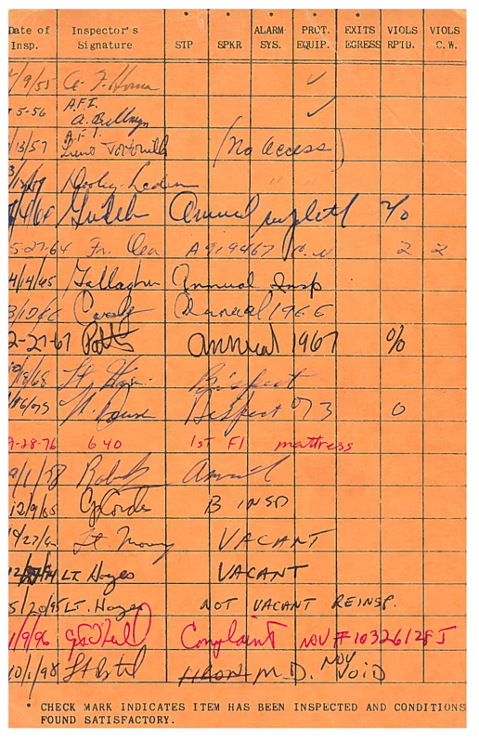
FDNY Tech
Pre-March 2013
Overview
Notes:
Roth: Main point:
[]

Slide 11





FDNY Tech: Current and Future Build
Coordinated Building Inspection Data Analysis System (CBIDAS)
Coordinated Building Inspection Data Analysis System (CBIDAS) Areas shaded in blue deployed city-wide as of 3/17/13; Areas shaded in green are slated to begin assessment, design, and development in 2013; Areas not shaded are slated for future enhancements. Inclusion of data from inter-agency interfaces will continue to expand thru the City Hall DEEP Initiative.
Intra-agency
and inter-agency
Interfaces
Risk-Based Inspection System
Risk-based Repository
01000110 01000100 01001110 01011001
01000110 01000100 01001110 01011001
01000110 01000100 01001110 01011001
01000110 01000100 01001110 01011001
01000110 01000100 01001110 01011001
EAP
FireCast
Portal Apps
eCIDS
BFI
RBIS inspection
application
COF
Fire
Operations
CBIDAS System
Data Repository / Warehouse
Fire Ops OLTP
NYFIRS
FPIMS
Operational and Analytical Reporting
DataBridge
BFP Inspection Tracking apps
Fire Prevention
DOB
Inter-agency
Interfaces
MapPLUTO
Consolidate all building and inspection information in
accessible data repository / warehouse
Data Share
DEP
New Revenue Management system
Fire
Investigation
Exchange critical building safety information with DOB, DEP and others
Overview
Handheld
11
Notes:
Need to get more digital data

Slide 12
If a building catches fire, it’s usually assumed to be random.
Bldg 1
Bldg 7
Bldg 13
Bldg 19
Bldg 25
Bldg 31
Bldg 2
Bldg 8
Bldg 14
Bldg 20
Bldg 26
Bldg 32
Bldg 3
Bldg 9
Bldg 15
Bldg 21
Bldg 27
Bldg 33
Bldg 4
Bldg 10
Bldg 16
Bldg 22
Bldg 28
Bldg 34
Bldg 5
Bldg 11
Bldg 17
Bldg 23
Bldg 29
Bldg 35
Bldg 6
Bldg 12
Bldg 18
Bldg 24
Bldg 30
Bldg 36
Overview
Notes:
Roth: Main point:
[]

Slide 13
But there may actually be patterns in the data.
Cond A
Cond B
Cond C
Cond D
Cond E
Cond F
Bldg 1
Bldg 7
Bldg 13
Bldg 19
Bldg 25
Bldg 31
Bldg 2
Bldg 8
Bldg 14
Bldg 20
Bldg 26
Bldg 32
Bldg 3
Bldg 9
Bldg 15
Bldg 21
Bldg 27
Bldg 33
Bldg 4
Bldg 10
Bldg 16
Bldg 22
Bldg 28
Bldg 34
Bldg 5
Bldg 11
Bldg 17
Bldg 23
Bldg 29
Bldg 35
Bldg 6
Bldg 12
Bldg 18
Bldg 24
Bldg 30
Bldg 36
Overview
Notes:
Roth: Main point:
[]

Slide 14
Pr(Fire) = f(Input Features)
Known as “Independent Variable” or “Input Feature”
Cond A
Cond B
Cond C
Cond D
Cond E
Cond F
Bldg 1
Bldg 7
Bldg 13
Bldg 19
Bldg 25
Bldg 31
Bldg 2
Bldg 8
Bldg 14
Bldg 20
Bldg 26
Bldg 32
Known as “Dependent Variable”, “Label” or “Target”
Bldg 3
Bldg 9
Bldg 15
Bldg 21
Bldg 27
Bldg 33
Bldg 4
Bldg 10
Bldg 16
Bldg 22
Bldg 28
Bldg 34
Bldg 5
Bldg 11
Bldg 17
Bldg 23
Bldg 29
Bldg 35
Bldg 6
Bldg 12
Bldg 18
Bldg 24
Bldg 30
Bldg 36
Overview
Notes:
Roth: Main point:
[]

Slide 15
Fire + Hot Spots
2002 to 2013
(500 foot grid cells)
Notes:
Chen: Main point:
But before building a model, we can use the data to develop an appreciation for historical fire risk
In this map, we divided NYC into a grids tabulating number of fires per grid area between 2002 and 2013
There are indeed hotspots of activity in Bronx, Manhattan and Central Brooklyn

Slide 16
Fire + Hot Spots
Residential Fires
(One + Two Family Homes)
Commercial
+ High-rise fires
(FireCast universe)
Notes:
Chen: Main point:
FDNY’s data is a wealth of codified digital knowledge and from it we may be able to identify consistent sources of fire risk.
If we map out where structural fires have occurred between 2003 and 2012, we find that incident patterns are quite different depending on building. Whereas residential fires in one and two family homes are spread between Brooklyn and Queens, the FireCast system is focused

Slide 17
Fire Incidence + Building Use
Notes:
Chen: Main point:
When we start stratifying the data, we begin to find disparities in fire incidence, namely across building types, such as hotels, medical centers, schools, residential homes
A striking yet unsurprising pattern emerges– buildings with greater consistent person volume and activity are correlated with higher fire incidence
For example elevator apartments, hotels, and theaters have far greater and consistent volumes of people moving through them than one-two family homes or rec centers

Slide 18



One Model for Citywide Use
FireCast 2.0:
Consistent Risk Model
Example building with risk score
99%
Structural
Prob( | )
Building Class = Elevator Apartment Building with Semi-Fire Proof Store
Built: 1915
Partial Sprinkler
Probability of fire ignition given structural characteristics
6 floors
DEFINITION
Previous Fires
or Injury
IMPACT
EXAMPLE
Impact (Avg # violations)
First 30 days = +19%
First 60 days = +10%
Pre-Incident Rate
16.5% of buildings that experience a fire were inspected within 90 days before the day of incident
Geography: Central Brooklyn
Giorgio’s
Street Frontage = 90ft
Proximity = Attached
2 buildings on tax lot,
Privately owned
Retail Sq. Ft = 6300 sf
FireCast 2.0
Notes:
Chen: Main point:
Thus, for the proof of concept model, research focused on identifying consistent sources of risk, which are readily available through structural characteristics
Formally, we defined risk as the probability of fire ignition given structural characteristics.
As such, if we look at one example of a risky building, such a building would be an elevator apartment constructed early in the 20th century with some retail space, 6 floors, located in central brooklyn among other factors. In total, we had a model with 13 variables that subdivide into 60 levels
FireCast 2.0 was deployed in July 2013 and within the first 30 days, we saw an increase in per building violation volume of 19%, which fell to 10% by day 60. As we later found, the worst of the consistently risky buildings are really concentrated in the top 5% or 15,000 buildings

Slide 19






One Risk Model per Incident Type for Each Battalion (49 models)
FireCast 3.0:
Machine Learning Model
Risk score: Depends
(
|
)
Structural
Building Class = Elevator Apartment Building with Semi-Fire Proof Store
Built: 1915
Partial Sprinkler
Prob
Depth
Width
DEFINITION
FORMULATION
6 floors
Behavioral Cues
Previous Fires
or Injury
Excessive Noise
Air Quality
Sidewalk Condition
Electrical Issues
Rodents
Lead
Seasonality
Sewer overflows
Heating problems
+22 other types
Geography: Battalion 2
Violation Activity
Giorgio’s
Sidewalk cleanliness
Loose Trash
Failure to Maintain
Signage, Postings
Work without permit
Illegal alteration
Accumulation of combustible waste
Missing certificates of fitness
Cert. of Occupancy not reflective
+19 other types
Street Frontage = 90ft
% Retail SF= 29.5%
%Residential SF= 70.5%
%Storage, %Factory, %Garage, %Office, %Other SF = 0%
2 buildings on tax lot,
Privately owned
Proximity = Attached
FireCast 3.0
Notes:
Chen: Main point:
The new FireCast system incorporates so much more digital signal and does so by custom tailoring 49 models for each battalion and each type of incident
We tested
In total, we have over 950 different factors that feed the model.
Structural characteristics now capture more functional use and structural characteristics
Behavioral information such as complaints are called in on a daily basis– about 5000 complaints citywide per day for excessive noise, cleanliness, air quality, housing problems
In addition, violation activity from 11 different agencies now will help prioritize our risk inspections

Slide 20
Risk Sequence of FDNY Battalion 2
← Time →
← Buildings →
Notes:
Main point:
The data inputs are quite dynamic.
This image represents our riskDNA or risk sequences for just one of FDNY’s battalions. Each row is a battalion and each column is a period in time. Red indicates high risk rank and blue means low risk rank.
We find that some buildings are just consistently risky, others jump around, and some are almost never risky

Slide 21
Roadmap
Motivation
Supervised Learning
OLS
Homework assignment
Intro to Data Science for Public Policy, Spring 2018

Slide 22
what is supervised learning?!
Predicting the chance that homes are with or without heat or electricity after a natural disaster.
Determining areas most likely to be hardest hit by a disaster
Mining raw data feeds to uncover critical levers to affect change in the field
Measuring the impacts of natural disasters and other extreme events.
Prioritizing or segmenting populations for specific action (e.g. patient triage)
Optimizing and reallocating resource deployment for inspections.
Identifying infrastructure that is most critical for homeland security protection.
Estimating outcomes from any policy question or risk mitigation initiative.
Monitoring for spikes in adverse activity.
Uses
Notes:
What is the definition?

Slide 23
what is supervised learning?!
Any empirical task where a set of target/examples/labels/dependent/Y
is predicted using corresponding predictors/independent/features/X. The predictions are constructed by mapping X’s to Y’s with the goal of minimizing prediction error.
Uses

Slide 24
what is supervised learning?!
It’s supervised because the algorithm is learning from the examples you provide it.
Uses

Slide 25
Elements of Supervised Learning
Intended Use
The Data
Algorithms
Experiment Design
Elements

Slide 26
Elements of Supervised Learning
Intended Use
Prediction vs. Estimation Relationships
Prediction problems usually indicate that there is a greater emphasis placed on empirical accuracy
Estimation of relationships places emphasis on human-interpretable insight
Elements
Notes:
Prediction problems tend are not necessarily causal. The goal is to find a quantitative representation of a phenomenon that uses data to accurately predict a quantity. For example, predicting a stock price, predicting what someone would want to watch on netflix, etc.
This is different from estimation of relationships, which is best described as an empirical decomposition or characterization of a relationship. For example, the marginal value of experience with respect to income. The marginal value of number of rooms in a house with respect to housing sales price

Slide 27
Elements of Supervised Learning
Intended Use
Strong prediction models can be used to direct attention and resources.
Estimation exercises can be used to inform general strategy, but often times do not have enough prediction power to lead to action.
Elements

Slide 28
Elements of Supervised Learning
Data
Inputs
Y/target/examples/labels/dependent
Continuous variable targets = regression
Discrete variable targets = classifiers
X/predictors/independent/features
Elements

Slide 29
Elements of Supervised Learning
Data
Core consideration: Units must fit the decision
Unit of analysis
Data pipeline
Elements
Notes:
While any data can be used to create a model, the model is only useful if the units fit the decision
Example: A fighter pilot and autopilot cannot control the plane if the flight instrument readings like altitude, speed, among other things are updated every 45 minutes
Unit of analysis such as time and geography must be refreshed at a rate that is approximately equal to the the decision time step

Slide 30
Elements of Supervised Learning
Question
If a fire unit inspects buildings on a schedule of every two days, how often does the data need to be updated?
Real-time
36 hours
72 hours
Weekly
Elements
Notes:
Data pipeline is an indication of whether the generation of new data is on a sufficiently quick pace to support a supervised learning model’s use.
Example:

Slide 31
Elements of Supervised Learning
Supervised Learning Algorithms
Are a series of rules and calculations that convert raw data into insight.
Parts
Input variables
Weights
Error and accuracy functions
Elements

Slide 32
Elements of Supervised Learning
Common error measures
Continuous variables
Root Mean Squared Error
Mean Absolute Percentage Error
Discrete
F-1 Score
Area Under the Curve
Elements
Notes:
Hard to interpret mean squared error because of the scale issue.

Slide 33
Elements of Supervised Learning
Supervised Learning Algorithms
Linear Regression
Y = B0 + B1X + E
Gradient Descent
R-squared, RMSE
Output of regression is an estimate of Y (Y-hat)
Elements
Notes:
Lasso can handle more variables than observations.
Lasso takes all variables and sifts out all the variables that don’t really add much , versus PCA which just takes k and goes less than k
Don’t ever use stepwise regression
Stepwise is contingent upon the order of the variables

Slide 34
Elements of Supervised Learning
Model validation and experiment design
For homeworks #1 and #2, suppose you were given a pre-written script with all the relevant code and all you had to do was change variable names based on step-by-step instructions. (too soon?)
What would I (and you) have learned about your ability to program solutions to technical problems?
Elements
Notes:
This is essentially what separates prediction vs. estimation

Slide 35
Elements of Supervised Learning
For homeworks #1 and #2, suppose you were given a pre-written script with all the relevant code and all you had to do was change variable names based on step-by-step instructions.
What would I (and you) have learned about your ability to program solutions to technical problems?
This would have demonstrate that one is able to fill in the blank
Example

Slide 36
Elements of Supervised Learning
For a model to be useful (including regression) to actually be useful, it must be accurate.
What constitutes accuracy?
Example

Slide 37
Icebreaker #1
#
pos
2 4 16 32
1 2 3 4 5 6
Given a data set, two values were randomly removed. Based on the examples, what will the 3rd and 6th values likely be?
Example

Slide 38
Icebreaker #1
#
pos
2 4 8 16 32 64
1 2 3 4 5 6
What is the pattern?
Example

Slide 39

Icebreaker #1
#
pos
2 4 8 16 32 64
1 2 3 4 5 6
$${y= 2}^{n}$$
Example

Slide 40
Icebreaker #2
#
pos
128 512 1024 2048
7 8 9 10 11 12
Based on the examples, what will the 8th and 12th values likely be?
Example

Slide 41
Icebreaker #2
#
pos
128 256 512 1024 2048 4096
7 8 9 10 11 12
What’s the pattern?
Example

Slide 42
Icebreaker #3
#
pos
1 1 2 3 8
1 2 3 4 5 6
The 5th value was randomly removed. What should it be?
Example

Slide 43
Icebreaker #3
#
pos
1 1 2 3 5 8
1 2 3 4 5 6
What’s the pattern?
Example

Slide 44

Icebreaker #3
#
pos
1 1 2 3 5 8
1 2 3 4 5 6
$${y= x}_{i−1}+x_{i−2}$$
Example

Slide 45
Icebreaker #4
#
pos
0.8 0.9 0.14 -.75 -.95 -.28
1 2 3 4 5 6
Based on the examples, what will the 6th value be?
Example

Slide 46
Icebreaker #4
#
pos
0.8 0.9 0.14 -.75 -.95 -.28
1 2 3 4 5 6
Based on the examples, what will the 6th value be?
Example

Slide 47
Icebreaker #4
#
pos
0.8 0.9 0.14 -.75 -.95 -.28
1 2 3 4 5 6
What’s the pattern?
Example

Slide 48
Icebreaker #5
#
pos
D A Z Z L E
1 2 3 4 5 6
Based on the examples, what will the 4th value be?
Example

Slide 49
Icebreaker #5
#
pos
D A Z Z L E
1 2 3 4 5 6
Based on the examples, what will the 4th value be?
Example

Slide 50
Icebreaker #5
#
pos
D A Z Z L E
1 2 3 4 5 6
What’s the pattern?
Example

Slide 51
Question
What is the difference between #1/#2 and #3/#4?
#1
2 4 [ ] 16 32 [ ]
1 2 3 4 5 6
#2
128 [ ] 512 1024 2048 [ ]
7 8 9 10 11 12
#3
1 1 2 3 5 [ ]
1 2 3 4 5 6
#4
0.8 0.9 0.14 -.75 -.95 -.28
1 2 3 4 5 6
#5
D A Z Z L E
1 2 3 4 5 6
Example

Slide 52
The Point
There’s no way to tell if a pattern/model/hypothesis is right until you test it.
Example
Notes:
From a statistical perspective, this is a fundamental difference between most of the social sciences and data science.
Most of quantitative economics is focused on characterization, but not prediction. Thus, when a model is produced for forecasting, model accuracies are built to predict things it already has seen. More on that later.

Slide 53
Model Validation
Train/Validate/Test – Process to choose models
Split data into three groups (70/15/15)
Run a model on training
Use model weights to predict validate, iterate
Final check is to predict test
Train
Validate
Test
Elements

Slide 54
Model Validation
Run regression
Predict validation sample, check error, if error is ok
Then predict test set as a final check
Train
Run regression
Validate
Test
Elements

Slide 55
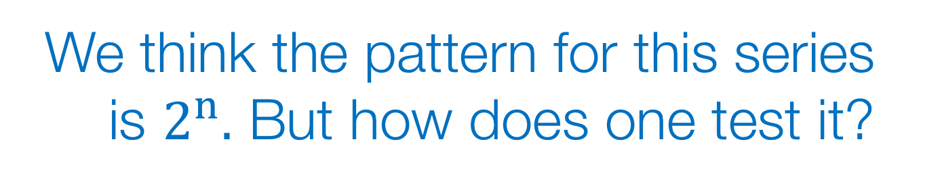
Icebreaker #1
Revisited
We think the pattern for this series is $2^{n}.$ But how does one test it?
2 4 8 16 32 64
1 2 3 4 5 6
128 256 512 1024 2048 4096
7 8 9 10 11 12
Example

Slide 56
Icebreaker #1
Step 1
Step 1: Randomly split into
train – validate - test samples
2 4 8 16 32 64
1 2 3 4 5 6
128 256 512 1024 2048 4096
7 8 9 10 11 12
Example

Slide 57
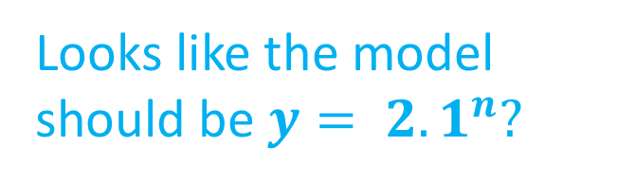
Icebreaker #1
Step 2-1
Step 2: Build model using train
Calculate accuracy on validate
2 4 8 16 32 64
1 2 3 4 5 6
128 256 512 1024 2048 4096
7 8 9 10 11 12
Looks like the model should be ${y= 2.1}^{n}?$
MAPE = 45%
(try again!)
Example

Slide 58
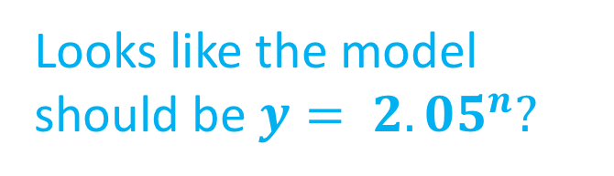
Icebreaker #1
Step 2-2
Step 2: Build model using train
Calculate accuracy on validate
2 4 8 16 32 64
1 2 3 4 5 6
128 256 512 1024 2048 4096
7 8 9 10 11 12
Looks like the model should be ${y= 2.05}^{n}?$
MAPE = 20%
(try again!)
Example
Notes:
Mean absolute percentage error -> 20%
MAPE is the final metric for evaluating how well it predicts

Slide 59
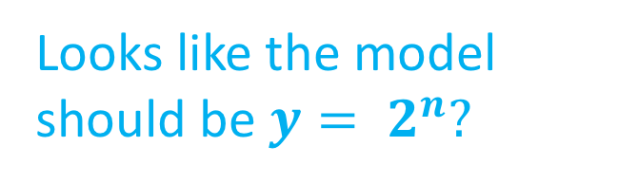
Icebreaker #1
Step 2-3
Step 2: Build model using train
Calculate accuracy on validate
2 4 8 16 32 64
1 2 3 4 5 6
128 256 512 1024 2048 4096
7 8 9 10 11 12
Looks like the model should be ${y= 2}^{n}?$
MAPE = 0%
Good!
Example

Slide 60
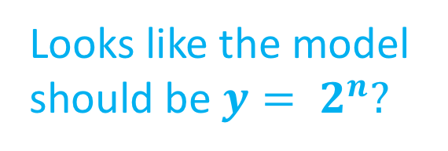
Icebreaker #1
Step 3
Step 3: Double check on test set
2 4 8 16 32 64
1 2 3 4 5 6
128 256 512 1024 2048 4096
7 8 9 10 11 12
Looks like the model should be ${y= 2}^{n}?$
MAPE = 0%
Good!
Example

Slide 61
Pros/Cons
PROS: Good for quick and dirty comparison of model accuracy.
CONS: Bad as model accuracy is based on only a couple of subsamples – higher variance when sample is split into large chunks.
Train
Run regression
Validate
Test
Elements
Notes:
Validate and test are just different samples.

Slide 62
K-folds cross validation (kCV)
Split data into k groups
Run a model on (k -1) groups
Predict the k^{th} group
Cycle through until all k groups are predicted
More k’s means lower variance on accuracy estimate
k = 1
k = 2
k = 3
k = 4
Elements

Slide 63
Icebreaker #1
Step 1
Step 1: Randomly split data into
K-folds (k = 4 below)
2 4 8 16 32 64
1 2 3 4 5 6
128 256 512 1024 2048 4096
7 8 9 10 11 12
Example

Slide 64
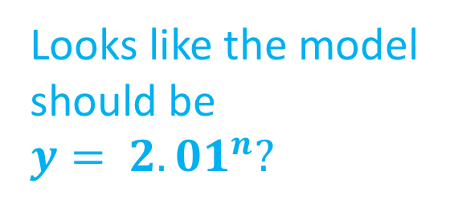
Icebreaker #1
Step 2-1
Step 2: Build model using k-1 folds
Predict on the kth, Record accuracy
2 4 8 16 32 64
1 2 3 4 5 6
128 256 512 1024 2048 4096
7 8 9 10 11 12
Looks like the model should be ${y= 2.01}^{n}?$
MAPE = 5.6%
Example

Slide 65
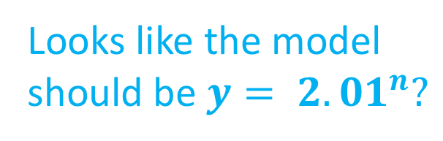
Icebreaker #1
Step 2-1
Step 2-2
Looks like the model should be ${y= 2.01}^{n}?$
MAPE =1%
2 4 8 16 32 64
1 2 3 4 5 6
128 256 512 1024 2048 4096
7 8 9 10 11 12
Example

Slide 66

Icebreaker #1
Step 2-1
Step 2-3
$${y= 2.01}^{n}?$$
MAPE = 2.5%
2 4 8 16 32 64
1 2 3 4 5 6
128 256 512 1024 2048 4096
7 8 9 10 11 12
Example

Slide 67

Icebreaker #1
Step 2-1
Step 2-4
2 4 8 16 32 64
1 2 3 4 5 6
128 256 512 1024 2048 4096
7 8 9 10 11 12
MAPE = 3.8%
$${y= 2.01}^{n}?$$
Example

Slide 68
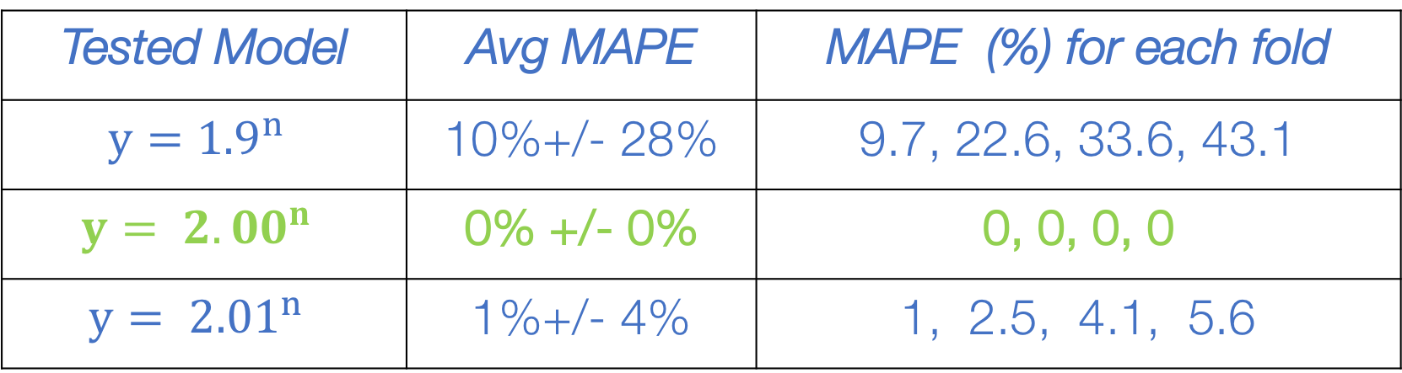
Icebreaker #1
Step 2-1
Step 3: Compare Accuracies
Tested Model | Avg MAPE | MAPE (%) for each fold
$${y=1.9}^{n}$$ | 10%+/- 28% | 9.7, 22.6, 33.6, 43.1
$${y= 2.00}^{n}$$ | 0% +/- 0% | 0, 0, 0, 0
$${y= 2.01}^{n}$$ | 1%+/- 4% | 1, 2.5, 4.1, 5.6
Example

Slide 69
Roadmap
Motivation
Supervised Learning
OLS
<break>
KNN
Homework assignment
Intro to Data Science for Public Policy, Spring 2018

Slide 70
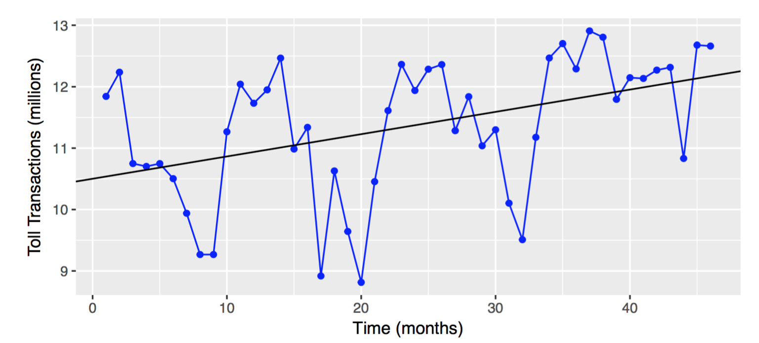
OLS

Slide 71
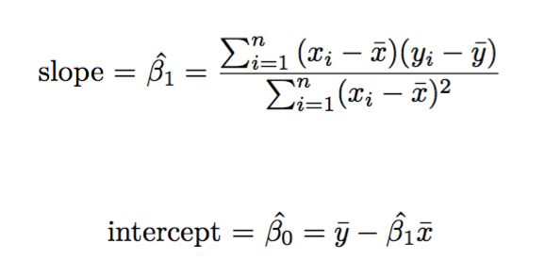
OLS

Slide 72
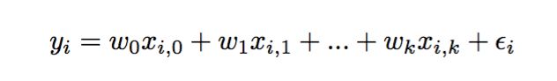
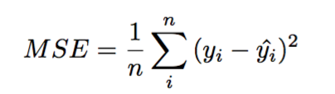
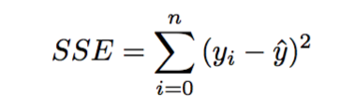
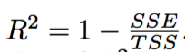
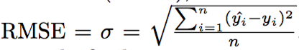
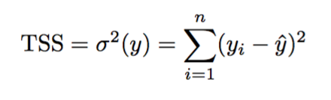
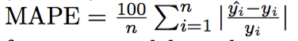
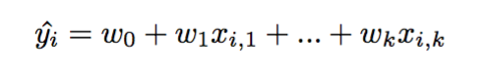
Start
Done!
Training model
If Error is acceptable?
Objective: Minimize MSE or SSE via gradient descent
N
Y
Evaluate Trained Model
Benchmark error
Prediction: Results in a linear equation that produces Y-hat
OLS Process
Notes:
Gradient descent – Look up gradient descent and try to code it at least once
Half of techniques rely on it
It’s a way to optimize an equation
Once the model is run, you’ll have a whole set of evaluation metrics
MAPE: Gives you the decimal point percentage change in how close predicted Y is to Y
Get an average of all of that divided by 100 to get to percent.
Low is good
Remember that you can’t divide by 0

Slide 73
Coefficients
W or B are coefficients. W1 to Wk are marginal estimates.
W1 = 0.036 million more transactions per month
Each W has an associated standard error
Elements

Slide 74
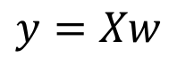
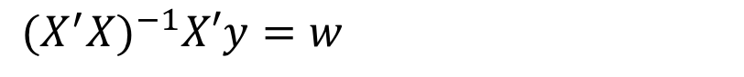
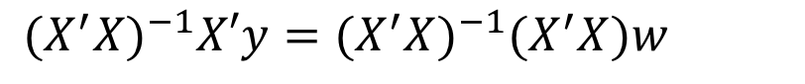
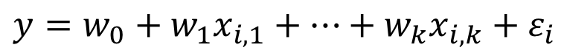
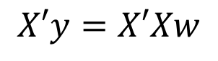
How Coefficients Are Derived
Algebraic version
$$y=w_{0}+w_{1}x_{i,1}+…+w_{k}x_{i,k}+ε_{i}$$
Matrix version
$$y=Xw$$
Solve for w
Multiply both sides by transpose X – make X neat square matrix
$$X′y=X′Xw$$
Take inverse
$${(X^{′}X)}^{−1}X′y={(X^{′}X)}^{−1}(X^{′}X)w$$
Solve for coefficients
$${(X^{′}X)}^{−1}X′y=w$$
Elements
Notes:
Have to include a column for the intercept
Math assumes you have a certain size matrix
The last thing above is what we’ll solve for in our first code along

Slide 75
R-squared
R-squared provides the proportion of variation explained by the model.
Variance of Y
Error between prediction and actual.
Elements

Slide 76
Error
Most common method of evaluating average error of predictions, but is not easily interpretted.
Mean absolute Percentage Error is a normalized measure of error
Elements

Slide 77
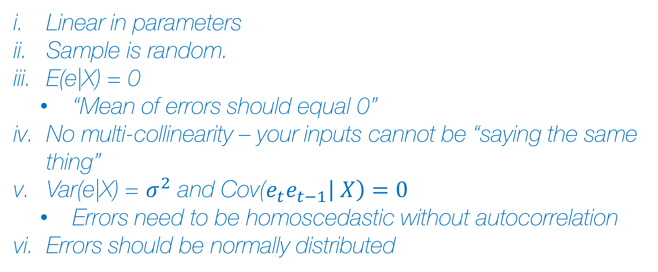
OLS Assumptions
Linear in parameters
Sample is random.
E(e|X) = 0
“Mean of errors should equal 0”
No multi-collinearity – your inputs cannot be “saying the same thing”
Var(e|X) = $σ^{2}$ and Cov($e_{t}e_{t−1}\left| X\right)=0$
Errors need to be homoscedastic without autocorrelation
Errors should be normally distributed
OLS

Slide 78
OLS Good/Bad
Good if talkable interpretation is needed
Good if there are relatively few data variables
Good if all relationships are linear
Bad if too many variables to choose from
Bad if there are non-linear and interactions in the data
OLS

Slide 79
Related models
LASSO Regression
Ridge Regression
Non-linear least squares
Robust regression – Median Absolute Deviation
Quantile regression
AutoRegressive Integrated Moving Average (ARIMA)
OLS

Slide 80
Coded example
Example #1 – Regression in matrix form
Example #2 – Regression model example
OLS

Slide 81
Homework
Homework assignment - Predicting Housing Prices – due at the beginning of next class, submit via blackboard
No class next week
Readings (in Lecture #6 zipfile)
Tibshirani (1996)
Hoerl and Kennard (1970)
Intro to Data Science for Public Policy, Spring 2018

